Slide 1
Neural Machine Translation With Attention Model

Slide 2
INTRODUCTION

Slide 3
Neural Machine Translation
Neural machine translation (NMT) is an approach to machine translation that uses a large artificial neural network to predict the likelihood of a sequence of words, typically modeling entire sentences in a single integrated model.
Deep neural machine translation is an extension of neural machine translation. Both use a large neural network with the difference that deep neural machine translation processes multiple neural network layers instead of just one.
NMT models use deep learning and representation learning.
The word sequence modeling was at first typically done using a recurrent neural network (RNN). A bidirectional recurrent neural network, known as an encoder, is used by the neural network to encode a source sentence for a second RNN, known as a decoder, that is used to predict words in the target language.

Slide 4
Neural machine translation is a newly emerging approach to machine translation. Unlike the traditional phrase-based translation system which consists of many small sub-components that are tuned separately, neural machine translation attempts to build and train a single, large neural network that reads a sentence and outputs a correct translation.
From a probabilistic perspective, translation is equivalent to finding a target sentence y that maximizes the conditional probability of y given a source sentence x, i.e., arg maxy p(y | x). In neural machine translation, we fit a parameterized model to maximize the conditional probability of sentence pairs using a parallel training corpus. Once the conditional distribution is learned by a translation model, given a source sentence a corresponding translation can be generated by searching for the sentence that maximizes the conditional probability.

Slide 5
Dataset
Limited the length of sentence to ten words for both hindi and English sentences.
We got 4914 sentences.
We took 3931 sentences for training and 983 sentences for testing.
There where 5602 different hindi words and 6317 English words.

Slide 6
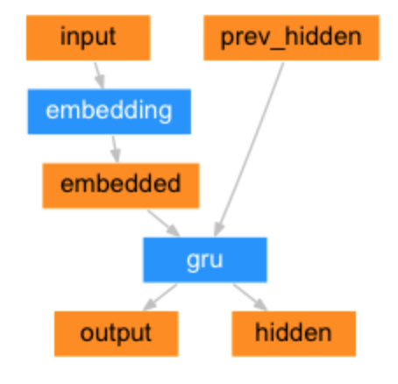
RNN ENCODER-DECODER

Slide 7
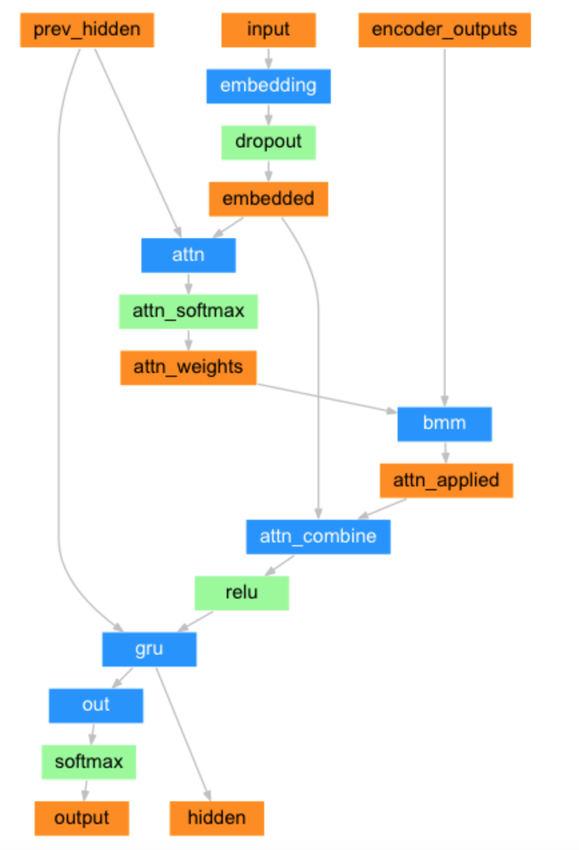
ATTENTION

Slide 8
HYPERPARAMETERS
Sentence Length=10 words
Train : Test= 80:20
Number of hidden unit in each GRU drop is 256
Number of Iterations is 40000
Used Stochastic Gradient desend

Slide 9
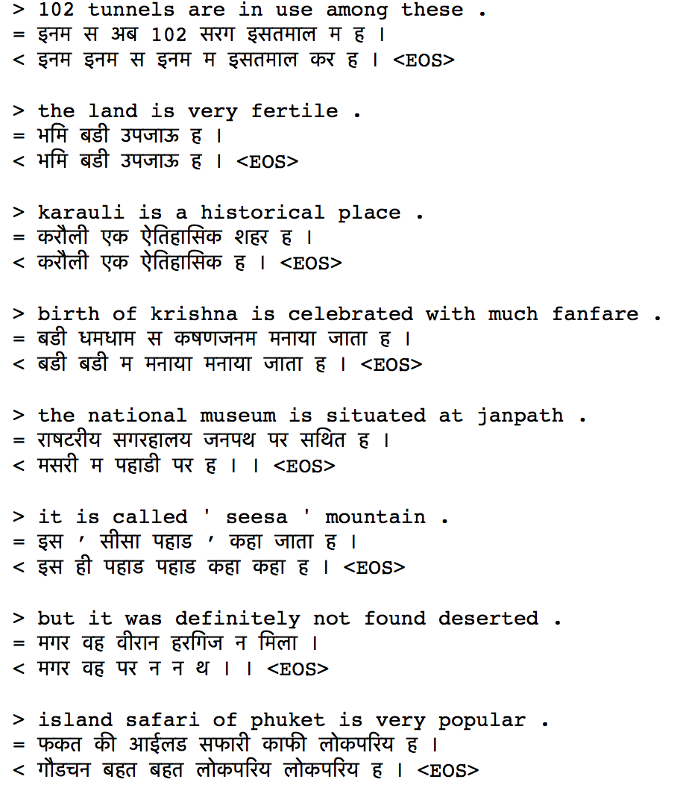
RESULTS
Loss: 1.9005

Slide 10
